Slide 1
MOVING TO CLASS DIAGRAMS
CIS 315 / BUND

Slide 2
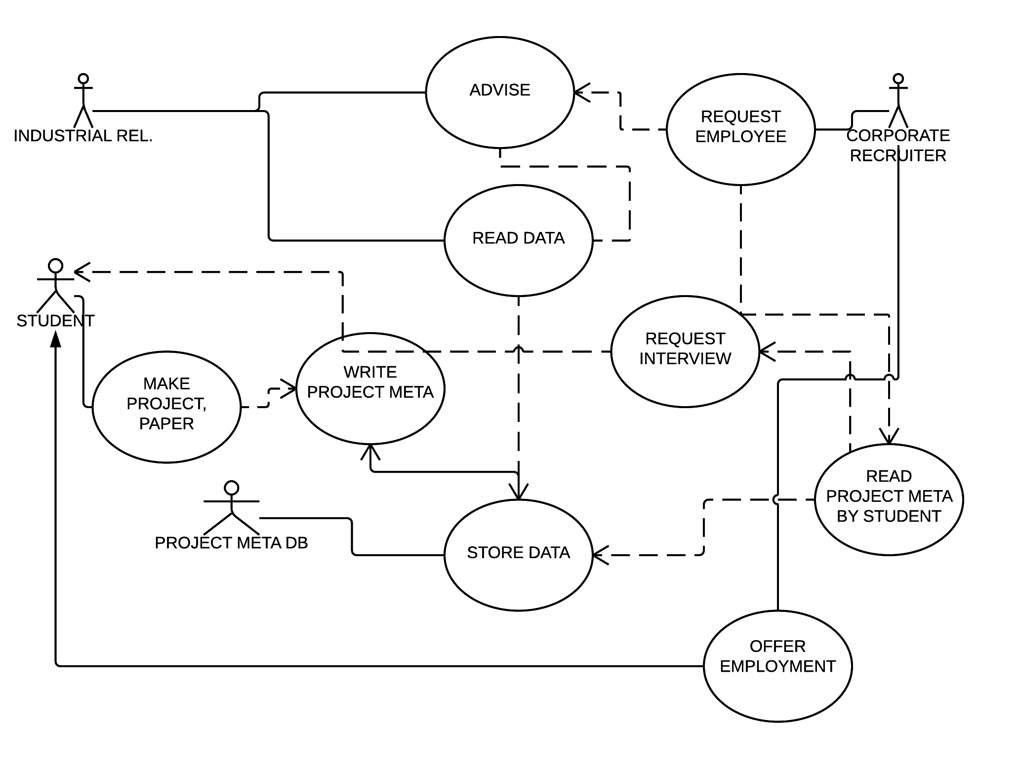
Use case, inspired by our Ishikawa

Slide 3
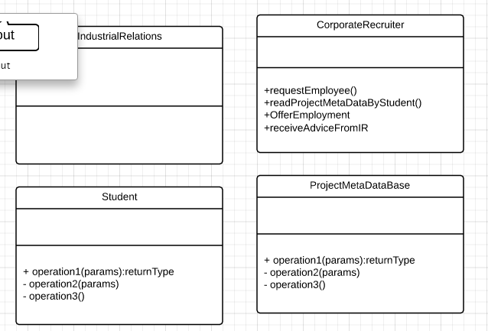
Transfer use cases to classes, as methods
Avoid defining variables for each class
Focus upon defining methods
Be careful to capture all details from your use case, where you interpreted all your corporate strategy!

Slide 4
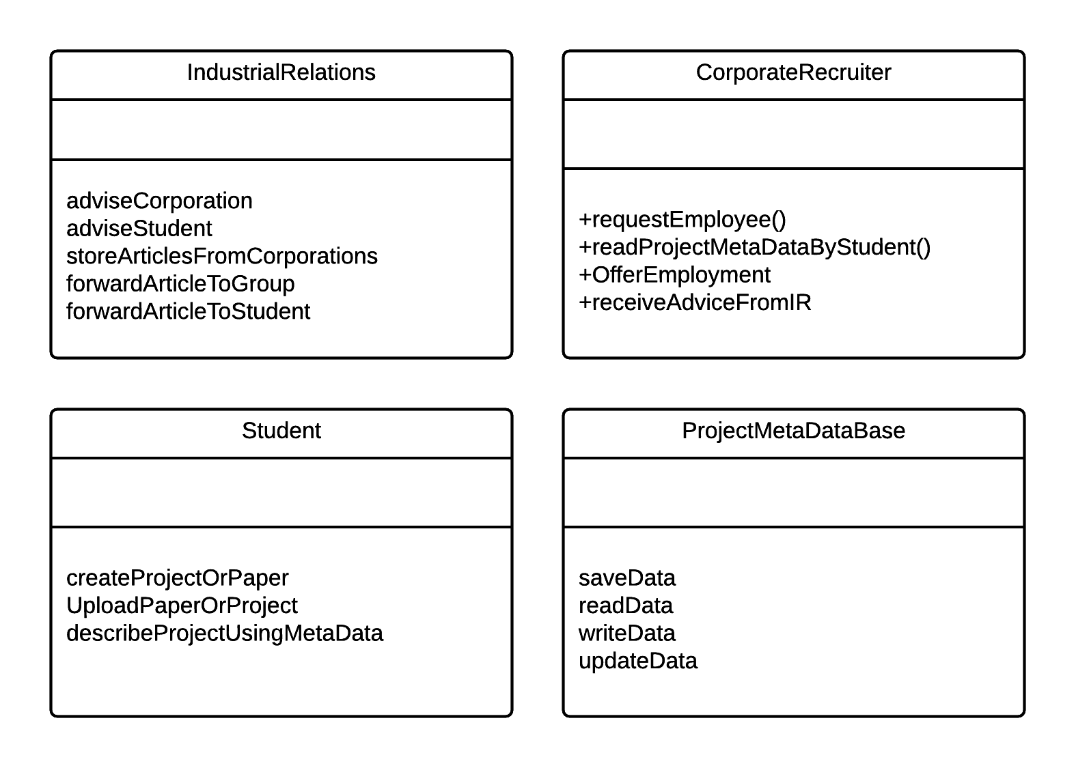
New class diagram: translated all use cases to methods all use case actors are now classes

Slide 5
classes
Know things
Member variables
Do things
Methods, functions
ALWAYS ANALYZE CLASSES USING THESE TWO FEATURES

Slide 6
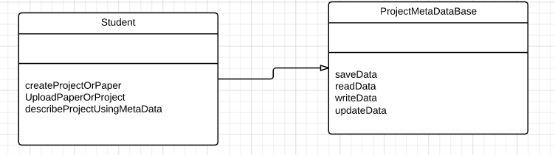
Inheritance means that something is something else, essentially

Slide 7
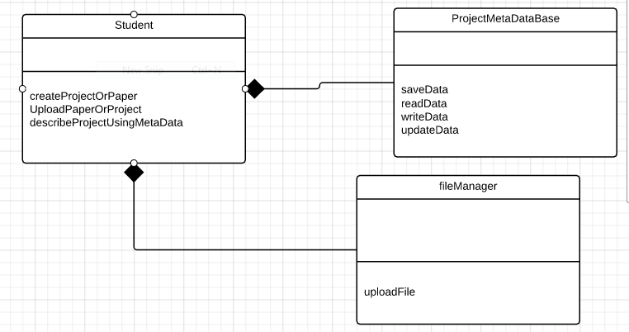
Composition: when an object uses another, but is not something else

Slide 8
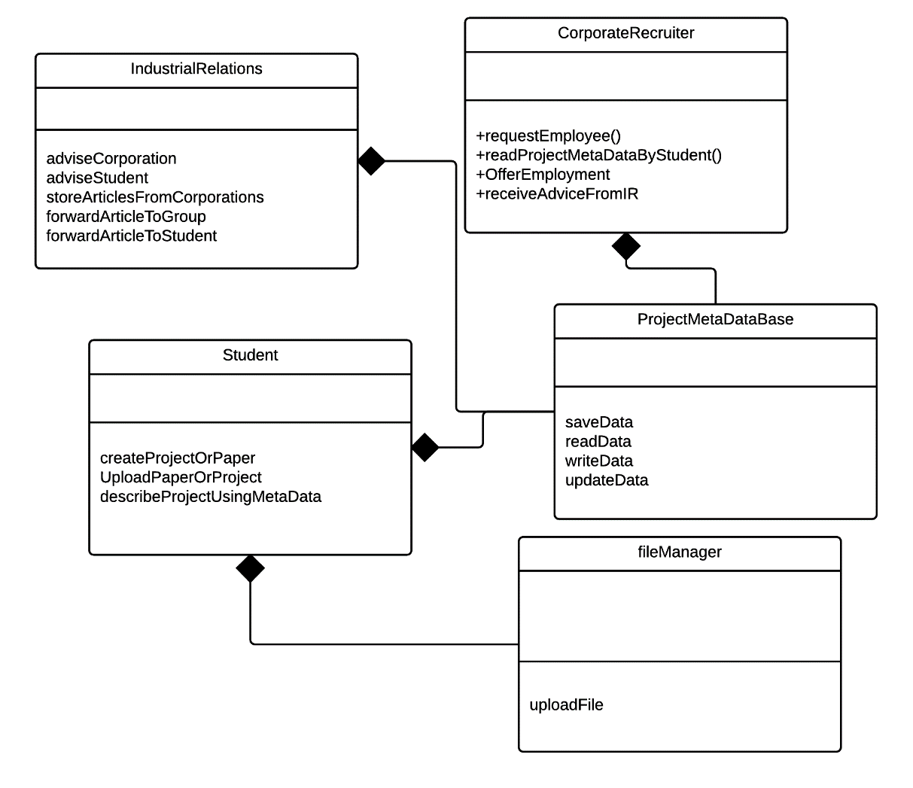
Every class depends upon db and file access, to some extent, therefore each object is somewhat of a composition

Slide 9
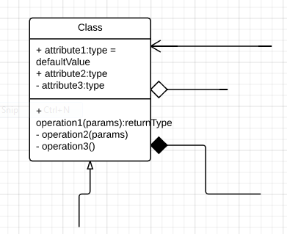
MAJOR RELATIONSHIPS BETWEEN OBJECTS
ASSOCIATION, CALLS UPON..
AGGREGATION, 1 TO MANY RELATIONSHIP
COMPOSITION, ONE TO ONE RELATIONSHIP
INHERITANCE, WHEN SOMETHING BORROWS COMPLETELY FROM ANOTHER CLASS, IMPLEMENTS ANOTHER CLASS’ METHODS AND VARIABLES

Slide 10
PHASE TWO
DESIGNING INHERITABLE OBJECTS

Slide 11
NEXT QUESTION TO ASK
WHAT DO YOUR MAJOR OBJECTS HAVE IN COMMON?

Slide 12
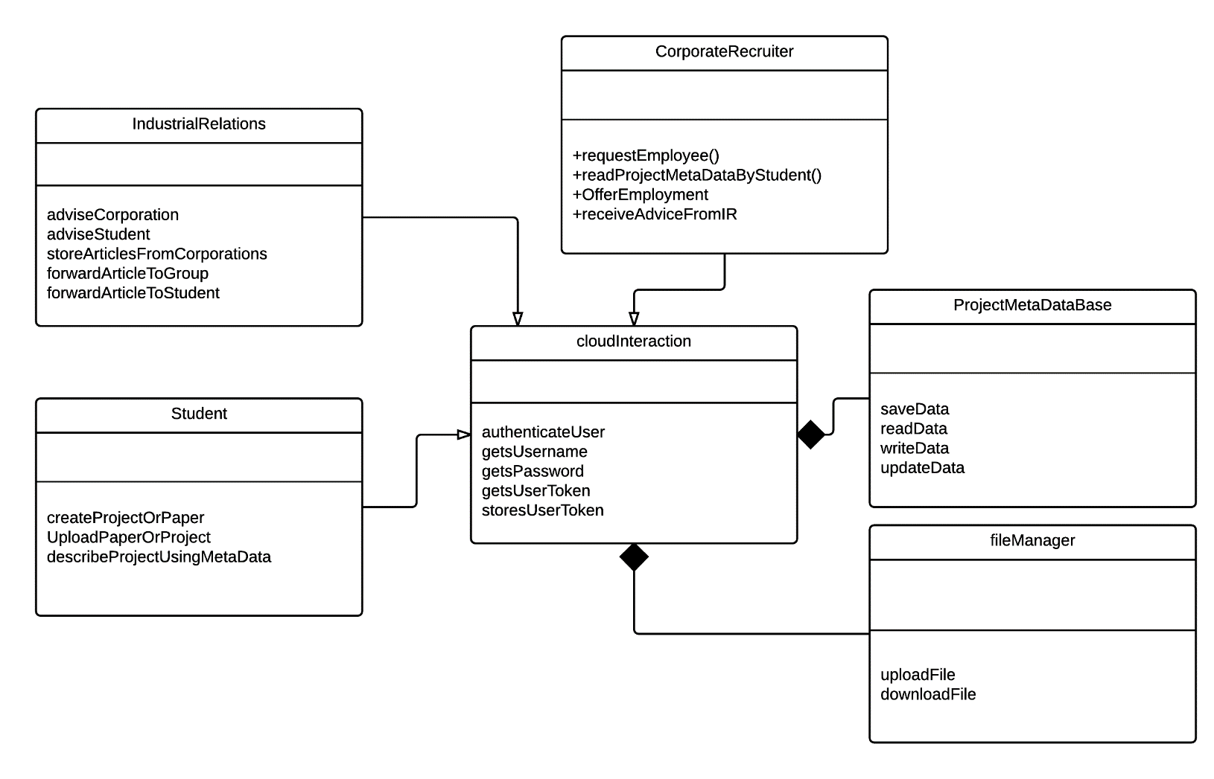
Find ways to make frequent coding operations easier to make especially frequent db calls, and the occasional file call
COMPOSITIONS HAPPEN HERE, WHERE WE CRAFT A TOOLBOX FOR EACH OBJECT TO USE
INHERITANCES ARE OCCURING HERE

Slide 13
SOME RECOMMENDATIONS TO MAKE TO THE PROGRAMMERS….
Where can certain objects be coded once, to provide vast time saving efficiency?
Analysis -> productivity
Analysis -> time saving
Hence we want all the analysis we can bear!

Slide 14
Static model: relationships only, no moving parts yet

Slide 15
Next time:
The static diagram, which you have now
Behavioral / dynamic diagram, which we’ll make, focus upon the real movement of data in a working application
Behavioral dia will reveal missing pieces from the static diagram

